Slide 1
ML HACKATHON MEGAKKART SALES ANALYSIS
By:- Prickly Pokers

Slide 2
Data Analysis - Objective
Megakkart (an e-commerce platform) is planning a ‘Super Festive Sale’ where it wants to achieve a GMV sales of INR 500 crores.
We need to analyse how the different factors from last year user data of Megakkart platform affects the revenue (Sale).
We need to identify whether the user on the web portal will make a purchase or not.
Provide hooks for the customers who are at a risk of not making a purchase.

Slide 3
Exploratory Data Analysis

Slide 4
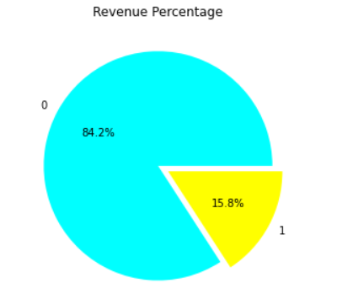
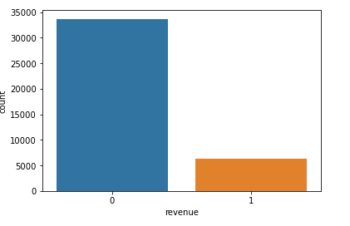
Analysing Sale/No Sale (revenue):
Key Inference –
From the above plot we can clarly see the percentage of people buying is much less than person buying from website

Slide 5
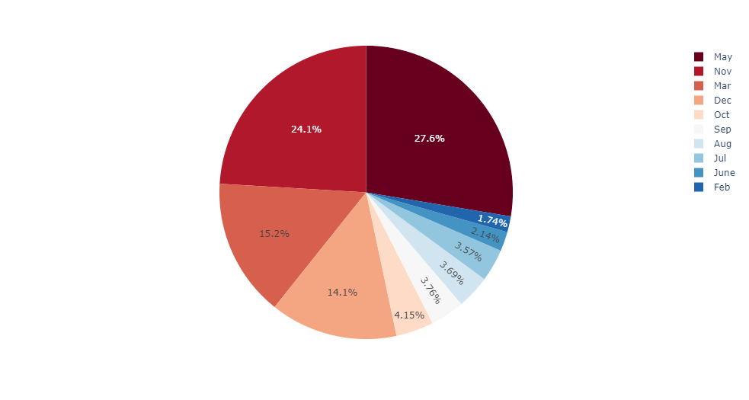
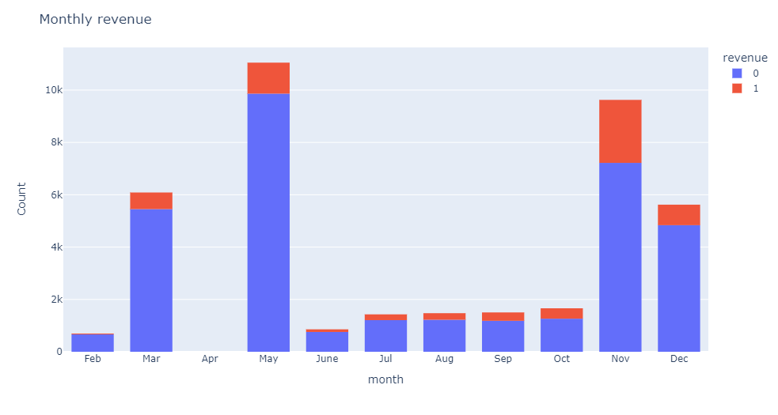
Exploratory Data Analysis
Analysing Traffic/Sales based on month:
Key Inference:
From the above graphs we can see that revenue has reached the highest value in the month of May and November

Slide 6
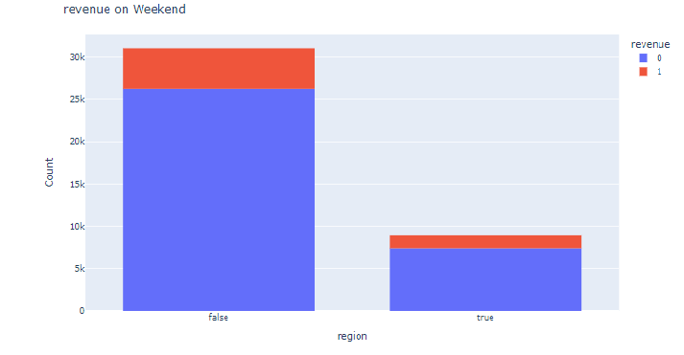
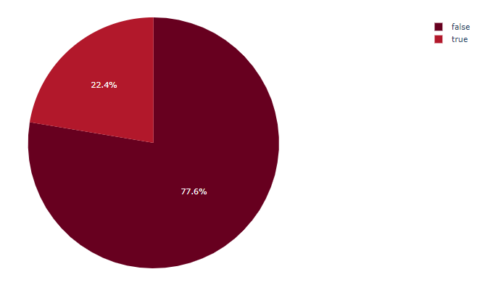
Exploratory Data Analysis
Analysing Traffic/Sales based on weekend:
Key Inference –
From the above graph we can clearly see that revenue has no effect on weekend.

Slide 7
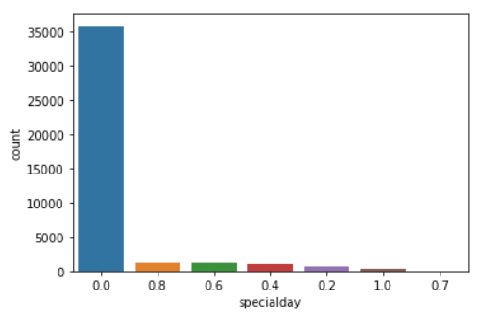
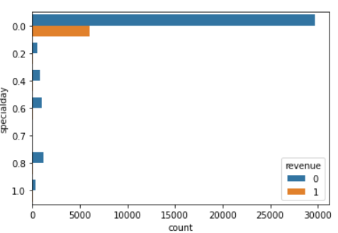
Exploratory Data Analysis
Analysing Traffic/Sales based on Special Days:
Key Inference –
There is least customer traffic on special days(with value 1). Most of the sale is happening outside special day window.

Slide 8
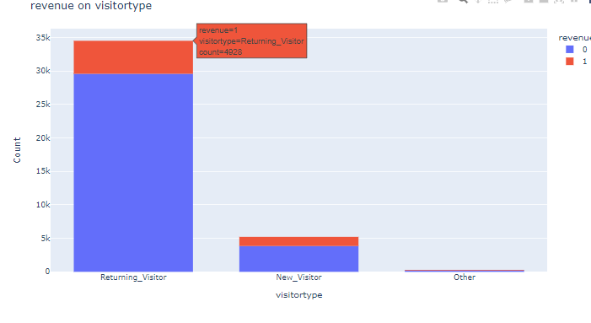
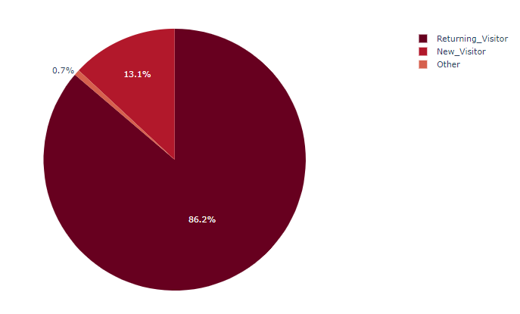
Exploratory Data Analysis
Analysing Traffic/Sales based on Visitor type:
Key Inference –
From the above graph we can clearly see that revenue count is highest for the Returning visitor.

Slide 9
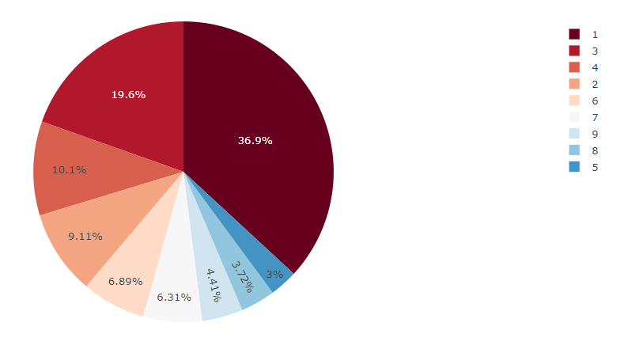
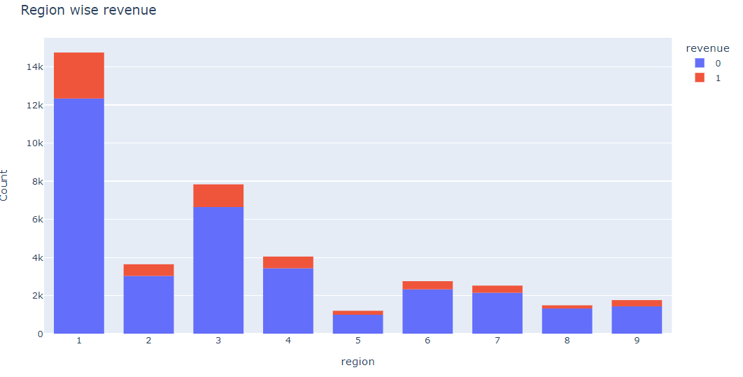
Exploratory Data Analysis
Analysing Traffic/Sales based on Region:
Key Inference –
Region type with the value 1 contributes to maximum revenue

Slide 10
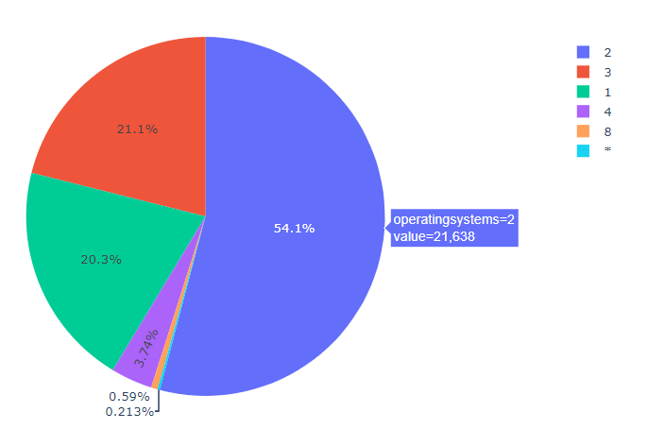
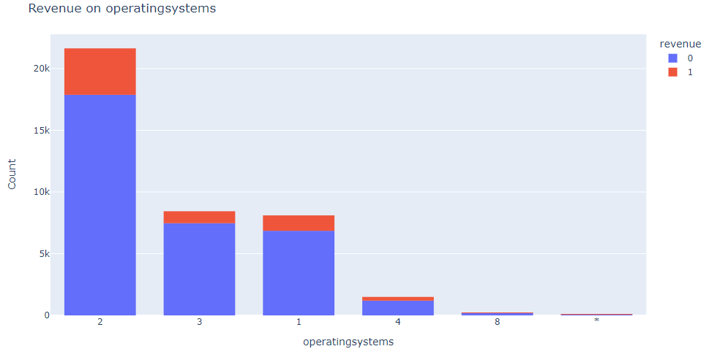
Exploratory Data Analysis
Analysing Traffic/Sales based on Operating System:
Key Inference –
Operating system with value 2 contributes to maximum revenue.

Slide 11
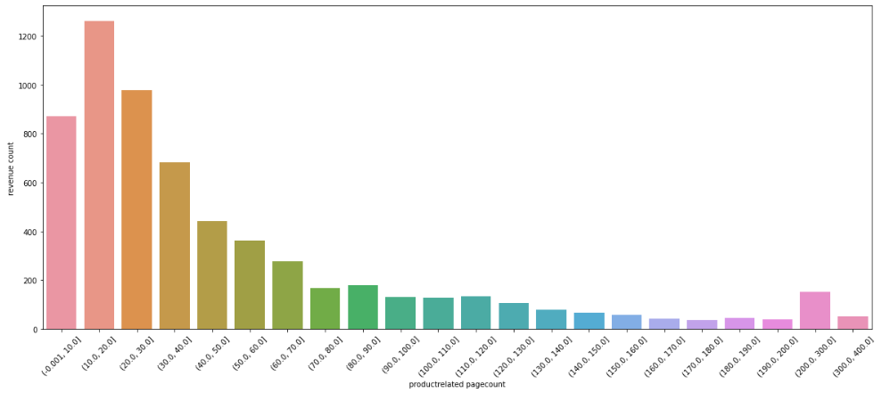
Exploratory Data Analysis
Analysing Traffic/Sales based on product related page views:
<<
Key Inference –
A moderate amount of product page viewing is leading to more revenue compared to very high page views.

Slide 12
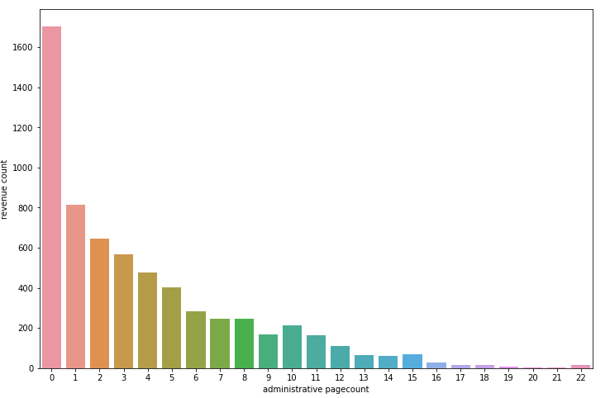
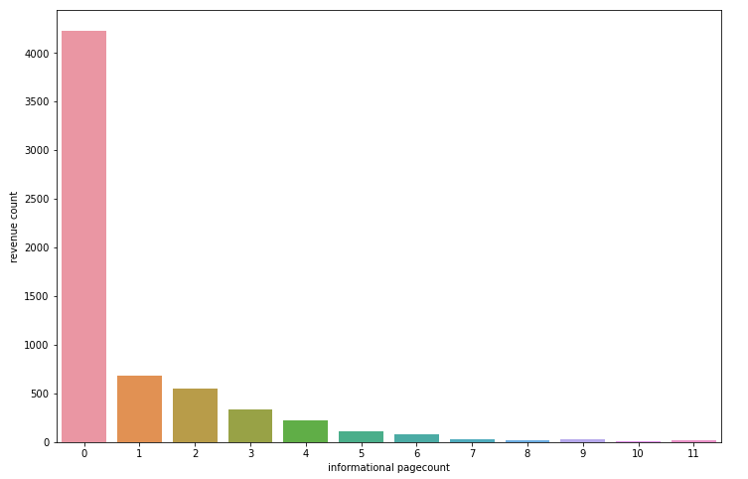
Exploratory Data Analysis
Analysing Traffic/Sales based on administrative/Informational page views:
<<<<<<
Key Inference –
As the page views for admin and information page increases, revenue always decreases. If page view is 0 for both admin and information, revenue is highest.

Slide 13
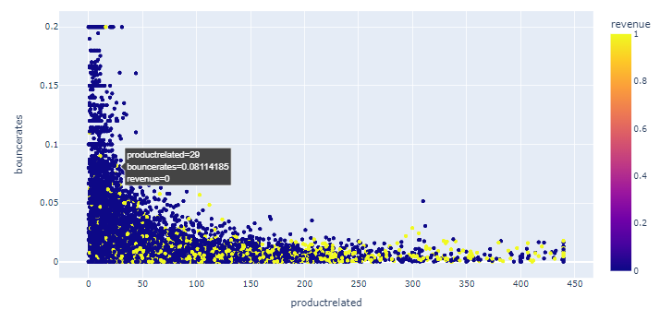
Exploratory Data Analysis
Analysing Traffic/Sales based on product related page views and Bounce rate :
Key Inference –
From the graph we can clearly see that as the bouncerate is increasing the number of blue dot is increasing. These blue dot indicate revenue is 0. So we can say that if the count of bouncerate is increasing probability of revenue becoming zero is increasing

Slide 14
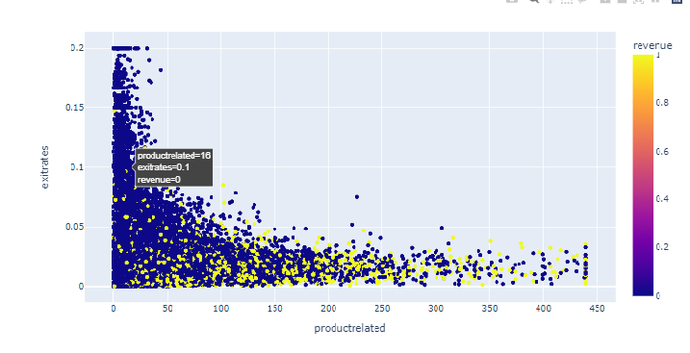
Exploratory Data Analysis
Analysing Traffic/Sales based on product related page views and Exit rate :
Key Inference –
From the graph we can clearly see that as the exitrates is increasing the number of blue dot is increasing. These blue dot indicate revenue is 0. So we can say that if the count of exitrates is increasing probability of revenue becoming zero is increasing

Slide 15
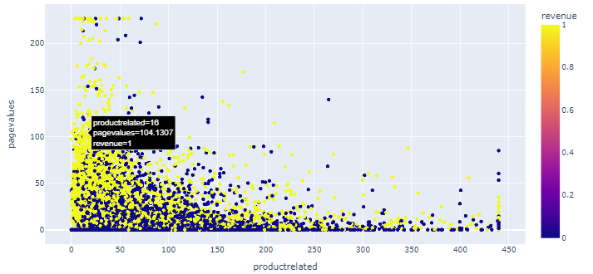
Exploratory Data Analysis
Analysing Traffic/Sales based on product related page views and Pagevalues :
Key Inference –
From the graph we can clearly see that as the Pagevalues is increasing the number of yellow dot is increasing. These yellow dot indicate revenue is 1. So we can say that if the count of Pagevalues is increasing probability of revenue becoming one is increasing

Slide 16
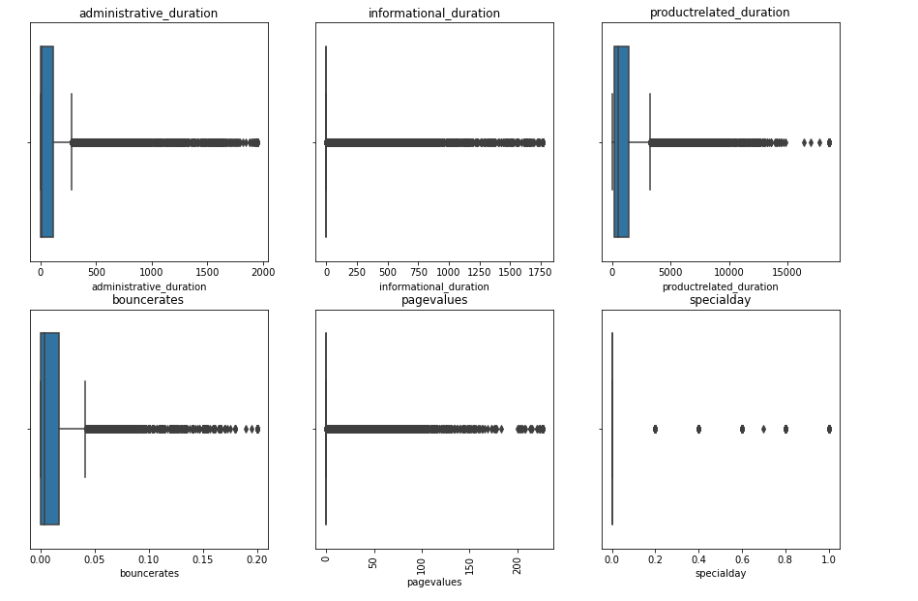
Outlier Detection
Since this user data is a real time data and part of an e-commerce platform, the outlier reported are accepted and hence can’t be removed.

Slide 17
Conclusion:
In order to achieve higher revenue during ‘Super Festive Sale’, we need to focus on following criterions:
As only May, Nov, March and December contributes to maximum traffic, some strategies need to be planned for other months (Specially for Jan and April).
As people are not visting site at the time of festival(special days), some strategies need to be planned during special days.
As returning customers are speding more time on site but purchasing less, some strategies need to be planned to attract existing customers.
Most of the revenue is coming from region 1 and 3, some strategies need to be planned to attract customers from other regions.
Main contribution is coming from Operating System 2, some strategies need to be planned to work on it.

Slide 18
THANK YOU

